Slide 1
Introduction to the Module

Slide 2
Session Overview
Introductions
Expectations
Module Outline
Assessment
Resourcing

Slide 3
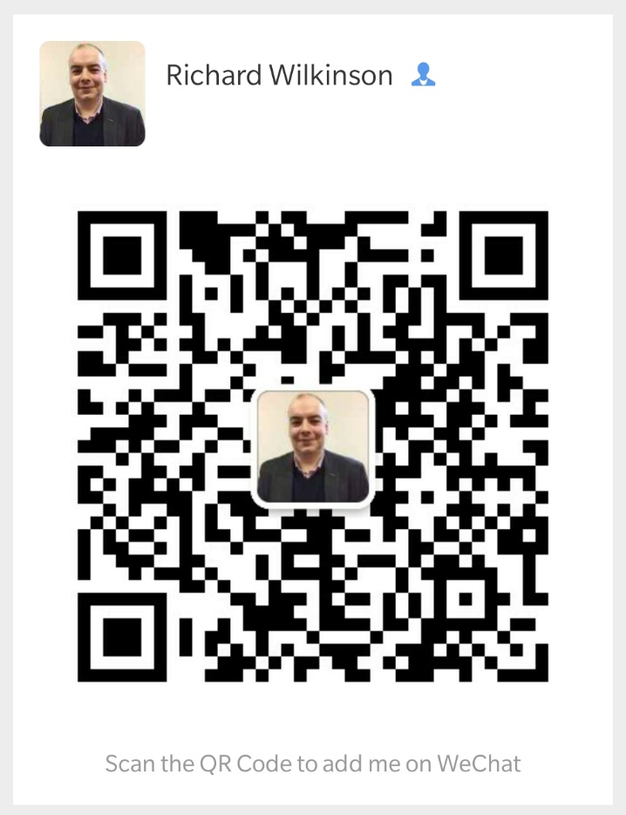
Richard Wilkinson, MSc, BA, PGCE, PGC, SFHEA, MBCS

Slide 4
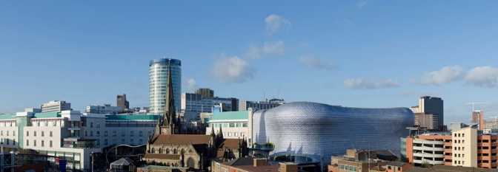
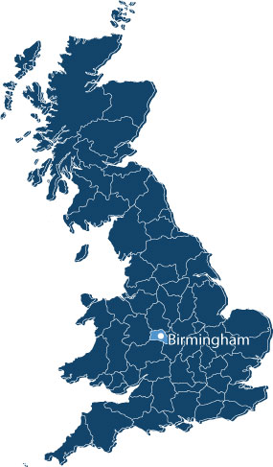
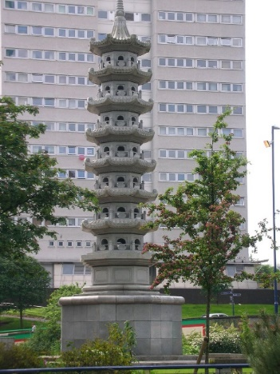
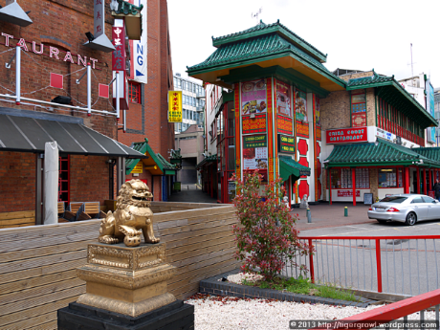
My Home Town
Birmingham – Have you heard of it?

Slide 5
Qualifications
MSc Computing
PGCE (PCE)
PG Cert. (Adult literacy / English Language)
B.A. Management & Media

Slide 6
Further Qualifications & Projects
Senior Fellowship of the HEA
Member of the British Computing Society
Prince2TM Project Management Certificated
Winner Coventry University Excellence Awards 2015; Outstanding Teaching Team of the Year
Nomination BCU Extra Mile Awards 2016; Engaging & Inspiring Teacher of the Year

Slide 7
Publications
Publications
Wilkinson, R & Lancaster, T. (2016) How Technology Can Be Used To Engage Higher Education Learners. The Chartered ABS.
Wilkinson, R & Lancaster, T. (2014) Improving Student Motivation Using Technology Within The STEM Disciplines. The H.E. Academy.

Slide 8
Projects
Projects & Products I Oversee at Worcester
Microsoft Dynamics CRM
IBM Watson Analytics

Slide 9
Teaching Experience
Computing
Programming & Scripting
Web and Databases
Information Systems
Computer Science
Network Technologies
Data Analysis
Open Source Systems
Research and Professional Practice
Business IT (BIT)
Consultancy and IT Management
ICT Infrastructure

Slide 10
Telecommunications
Six years of pre-sales consultancy management experience, including managing the staff along with the sales
Project Management experience of installation of voice & data solutions nationwide.

Slide 11
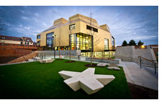
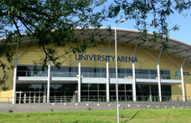
Worcester
Worcester has become so popular because we have:
Highly relevant, very professional courses.
Excellent, inspiring teaching.
A truly friendly, inclusive approach with excellent student support.
An outstanding record of graduate employment.
A beautiful home in historic Worcester.

Slide 12
What I Expect of You
Print my slides or download and read on your computer, so you can make notes and read as we go through the slides.
If you have any questions - raise your hand.
If you have an answer to a question - raise your hand.
Please be quiet in the class room.
any talk is outside the classroom.
any “alternative” reading is outside the classroom.
any playing Games is outside the classroom.
any sleeping is at your own home.

Slide 13
Module Outline
The module will be broken down into Units of Learning.
Unit | Topic | Content | Software Required
1 | Logic | CPU Functioning and Maths for Computing, using Gate Simulator to learn Boolean Logic | Logic Gate Simulator
2 | Virtualisation | Creating a virtual machine Installing an OS on a virtual machine Installing software/Apps on virtual machine (Linux) Creating an Appliance from a Virtual machine Discussion on the business uses of virtualisation to include group activity | VirtualBox 6.0.4 Oracle VM VirtualBox Extension Pack
3 | Linux Tutorial | Learning a range or terminal commands in Linux to gain a greater understanding of Operating Systems and Computer Architecture | Linux Ubuntu 18.04.1 LTS
4 | Networking | Using Cisco Packet Tracer to look at creating and configuring networks in a virtual environment, this will include understanding DHCP, DNS, Subnets, Subnet Masks, TCP/IP & IP Routing along with the OSI 7-Layer Model | Cisco Packet Tracer

Slide 14
Assessment
During the module you will be asked to complete a number of workbooks on the topics that I will be teaching.
These will be submitted to me via Blackboard for grading.
There will also be a group presentation on the topic of Virtualisation from the syllabus.
You attendance will also contribute to your final grade (10%).

Slide 15
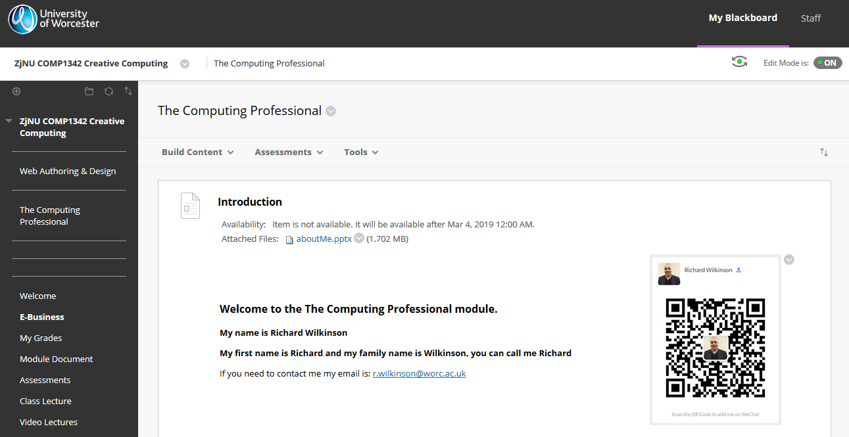
Blackboard 1

Slide 16
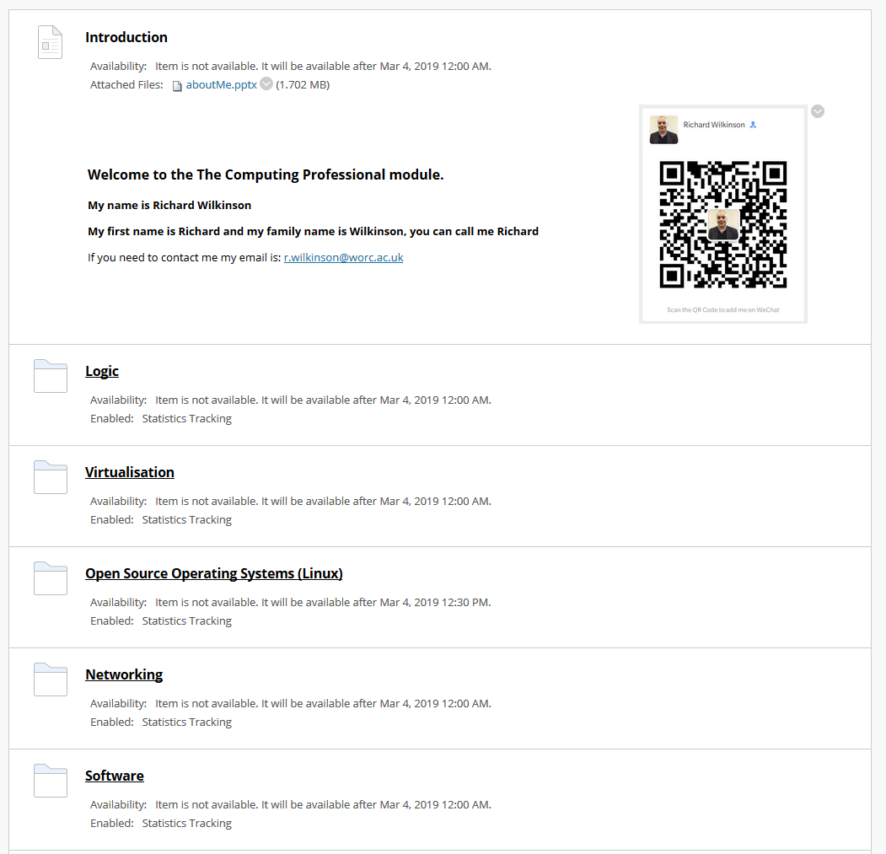
Blackboard 2

Slide 17
Blackboard 3
This is also all to be found on the USB Flash Drives I have for each of you.

Slide 18
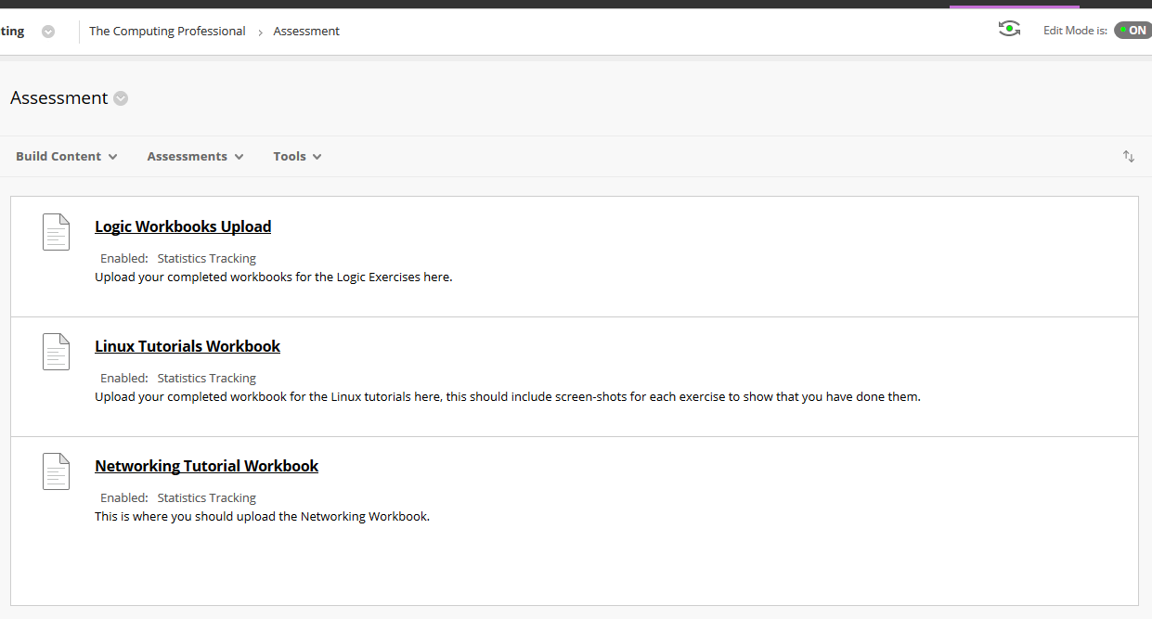
Assignment Submission

Slide 19
Assignment Submissions
You will submit your work to me via Blackboard for grading.
The deadline for this work to be completed is; Monday, 25th March at Midnight your local time.

Slide 20
Questions?

