Slide 1
Linux Introduction
Richard Wilkinson, MSc, BA, PGCE, PGC, SFHEA, MBCS

Slide 2
Overview
What is Unix/Linux?
History of Linux
Features Supported Under Linux
The future of Linux
Notes:
If you are here you probably wonder about what is Linux and if it will be a good idea to switch to use Linux instead of Windows.
Today class is an introductory class for Linux. Class following this one will be hands on Linux introduction.

Slide 3
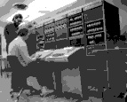
Before Linux
In 80’s, Microsoft’s DOS was the dominated OS for PC
Apple MAC was better, but expensive
UNIX was much better, but much, much more expensive. Only for minicomputer for commercial applications
People was looking for a UNIX based system, which is cheaper and can run on PC
Both DOS, MAC and UNIX were proprietary, i.e., the source code of their kernel is protected
No modification is possible without paying high license fees

Slide 4
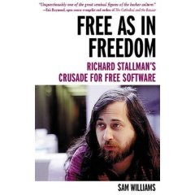
GNU project
Established in 1984 by Richard Stallman, who believes that software should be free from restrictions against copying or modification in order to make better and efficient computer programs
GNU is a recursive acronym for “GNU's Not Unix”
Aim at developing a complete Unix-like operating system which is free for copying and modification
Companies make their money by maintaining and distributing the software, e.g. optimally packaging the software with different tools (Redhat, Slackware, Mandrake, SuSE, etc)
Stallman built the first free GNU C Compiler in 1991. But still, an OS was yet to be developed

Slide 5
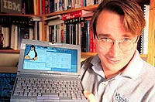
Beginning of Linux
A famous professor Andrew Tanenbaum developed Minix, a simplified version of UNIX that runs on PC
Minix is for class teaching only. No intention for commercial use
In Sept 1991, Linus Torvalds, a second year student of Computer Science at the University of Helsinki, developed the preliminary kernel of Linux, known as Linux version 0.0.1

Slide 6
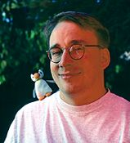
Message from Professor Andrew Tanenbaum
" I still maintain the point that designing a monolithic kernel in 1991 is a fundamental error. Be thankful you are not my student. You would not get a high grade for such a design :-)“
(Andrew Tanenbaum to Linus Torvalds)
Soon more than a hundred people joined the Linux camp. Then thousands. Then hundreds of thousands
It was licensed under GNU General Public License, thus ensuring that the source codes will be free for all to copy, study and to change.

Slide 7
Linux Today
Linux has been used for many computing platforms
PC, PDA, Supercomputer,…
Not only character user interface but graphical user interface is available
Commercial vendors moved in Linux itself to provide freely distributed code. They make their money by compiling up various software and gathering them in a distributable format
Red Hat, Slackware, etc

Slide 8
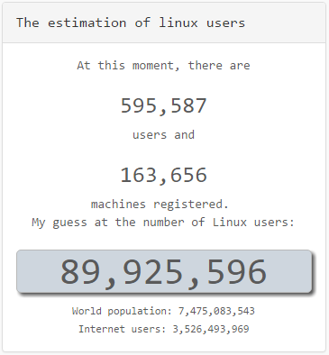
Growing and growing…
In order to encourage wide dissemination of his OS, Linus made the source code open to public.
At the end of 1992 there were about a hundred Linux developers. Next year there were 1000. And the numbers multiplied every year.
If you run Linux, add your machine at Linux Counter

Slide 9
Linux - free software
Free software, as defined by the FSF (Free Software Foundation), is a "matter of liberty, not price." To qualify as free software by FSF standards, you must be able to:
Run the program for any purpose you want to, rather than be restricted in what you can use it for.
View the program's source code.
Study the program's source code and modify it if you need to.
Share the program with others.
Improve the program and release those improvements so that others can use them.

Slide 10
Linux Shell
whoami
ls
pwd
Shell interprets the command and request service from kernel
Similar to DOS but DOS has only one set of interface while Linux can select different shell
Bourne Again shell (Bash), TC shell (Tcsh), Z shell (Zsh)
Bash, Tcsh, Zsh
Kernel
Different shell has similar but different functionality
Bash is the default for Linux
Graphical user interface of Linux is in fact an application program work on the shell

Slide 11
Linux Distributions
Linux Mint
Ubuntu
Debian GNU/Linux
Mageia
Fedora
openSUSE
Arch Linux
CentOS
PCLinuxOS
Slackware Linux
FreeBSD
… And many more
Source: https://distrowatch.com

Slide 12
Linux For Human Beings

Slide 13
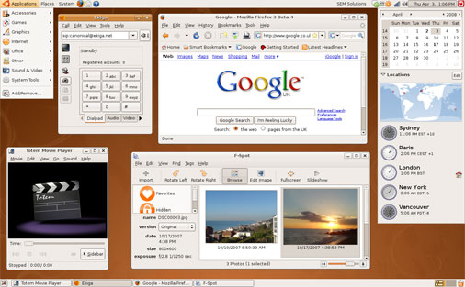
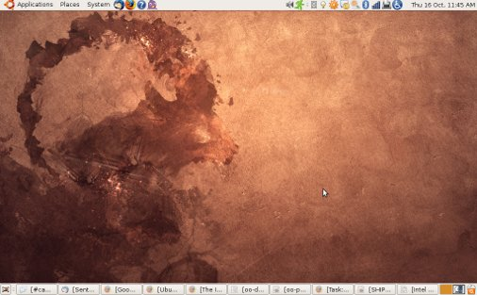
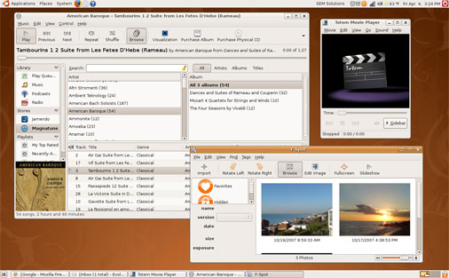
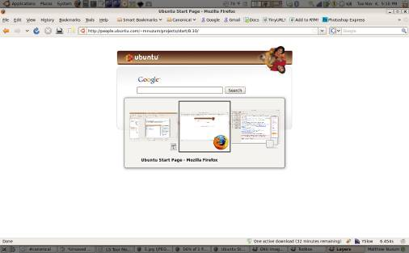
Gallery

Slide 14
What is Ubuntu?
Ubuntu (pronounced oo-BOON-to) is a Linux-based operating system that is open sourced (free)
Ubuntu is an African concept meaning “humanity towards others”
Ubuntu is sponsored by Canonical Ltd. owned by South African billionaire Mark Shuttlewort – the Ubuntu creator

Slide 15
Why Ubuntu?
Ubuntu has strong focus on usability and ease of installation
Ubuntu comes with lots of programs preinstalled (OpenOffice, Firefox web-browser, games, tweak tools)
Ubuntu is absolutely free

Slide 16
System requirments
Current version – 8.10 Intrepid Ibex
Next version – 9.04 Jaunty Jackalope
256 Mb RAM
3 Gb hard drive space
Can be dual booted with currents OS or used from a live CD in a fully efficient mode

Slide 17
Ubuntu 8.10 distro includes
Firefox 3 web-browser
Thunderbird and Evolution e-mail
OpenOffice suit
Gimp (Photoshop-like editor)
Music and video players
Mini-games

Slide 18
Summary
Pro
Con
Open source (and free)
Every 6 months upgrade available
Compatible with MS programs
Many add-ons available
No key codes, activation, registration
High performance. No more slow PC!
New generation of desktop themes
Long term excellent no-wait support
No viruses almost
Fast release cycle
Drivers for peripherals are not always available
PC games are not compatible
No non-free video and audio codec's preinstalled (mp3,mp4,divx,ffdshow)
Not all PC programs are compatible

Slide 19
How to get Ubuntu
The three ways to acquire:
Download from the Internet (www.ubuntu.com or local mirror)
Get a CD with Ubuntu absolutely free directly to you post-box (www.shipit.ubuntu.com)

Slide 20
Ubuntu alternatives
Ubuntu Kylin (Chinese Version)
Ubuntu (with Gnome)
Kubuntu (with KDE)
Xubuntu (with Xfce) for slower PC’s
Edubuntu (for educational purposes)
Gobuntu
Goobuntu (directly from Google)

Slide 21
System menu
Log Out
About
Help
Lock Screen
Preferences
System Settings: configuration tools that are for administrative purposes and usually require root access; that is, when those applications are started, the root password must be entered to continue.

Slide 22
Some Applications
Mozilla Firefox web browser
Thunderbird mail client and personal information manager
OpenOffice.org Writer is a word processing program
OpenOffice.org Impress is for creating and giving presentations
OpenOffice.org Calc is a spreadsheet tool
Note: There is another way to add an application launcher to the menu panel if the application is already listed in the Applications menu. Navigate to the application in the Applications menu, right-click on the application, and select Add this launcher to panel.

Slide 23
Other software installed
Audio Player: The XMMS (X Multimedia System), which is used to play digital sound files
CD Player: The default CD player
Sound Juicer CD Ripper: Burn your own CDs
Messaging Client: GAIM supports AIM, MSN, ICQ, and many other popular IM networks
gFTP: Useful for grabbing files through FTP (File Transfer Protocol)

Slide 24
The Desktop Area
Computer - This contains all volumes (or disks) mounted on the computer. These are also listed in the Places menu. Computer is equivalent to My Computer on Microsoft Windows.
Home - This is where the logged-in user stores all files by default, such as music, movies, and documents. There is a different home directory for each user, and by default users cannot access each others' home directories. Home is equivalent to My Documents on Microsoft Windows.
Trash - Deleted files are moved to Trash. Empty Trash by right-clicking the icon and clicking Empty Trash.
To permanently delete a file and bypass the file's move to Trash, hold down the [Shift] key when deleting the file.
Right-clicking on the desktop presents a menu of actions related to the desktop area. For example, clicking on Change Desktop Background lets you choose a different image or photograph to display on the desktop. It is possible to choose not to have any desktop background.

Slide 25
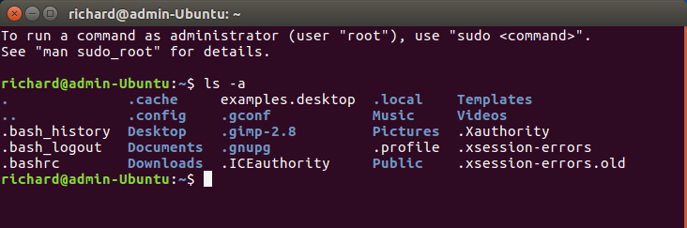
All LINUX commands start with the name of the command and can be followed by options and arguments.
Linux text-based interface
command to show the content of current directory
command to show the content of current directory with added option (-a) for all
The prompt $ shows that bash shell is using

Slide 26
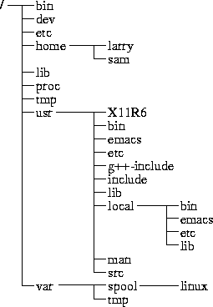
File Management – The Directory Tree
(root)
When you log on the the Linux OS using your username you are automatically located in your home directory.
Notes:
Root Directory ( / )
Top of the file system. Similar to \ in DOS
/bin
Contain the binary (executable code) of most essential Linux commands, e.g. bash, cat, cp, ln, ls, etc.
/boot
Contain all the files needed to boot the Linux system, including the binary of the Linux kernel. E.g., on Red Hat Linux 6.1, the kernel is in /boot/vmlinux-2.2.5-15 file
/dev
Contain the special files for devices, e.g. fd0, hd0, etc.

Slide 27
The most important subdirectories inside the root directory are:
/bin : Important Linux commands available to the average user.
/boot : The files necessary for the system to boot. Not all Linux distributions use this one. Fedora does.
/dev : All device drivers. Device drivers are the files that your Linux system uses to talk to your hardware. For example, there's a file in the /dev directory for your particular make and model of monitor, and all of your Linux computer's communications with the monitor go through that file.
/etc : System configuration files.
/home : Every user except root gets her own folder in here, named for her login account. So, the user who logs in with linda has the directory /home/linda, where all of her personal files are kept.
/lib : System libraries. Libraries are just bunches of programming code that the programs on your system use to get things done.

Slide 28
The most important subdirectories inside the root directory are:
/mnt : Mount points. When you temporarily load the contents of a CD-ROM or USB drive, you typically use a special name under /mnt. For example, many distributions (including Fedora) come, by default, with the directory /mnt/cdrom, which is where your CD-ROM drive's contents are made accessible.
/root : The root user's home directory.
/sbin : Essential commands that are only for the system administrator.
/tmp : Temporary files and storage space. Don't put anything in here that you want to keep. Most Linux distributions (including Fedora) are set up to delete any file that's been in this directory longer than three days.
/usr : Programs and data that can be shared across many systems and don't need to be changed.
/var : Data that changes constantly (log files that contain information about what's happening on your system, data on its way to the printer, and so on).

Slide 29
Home directory
You can see what your home directory is called by entering
pwd (print current working directory)

Slide 30
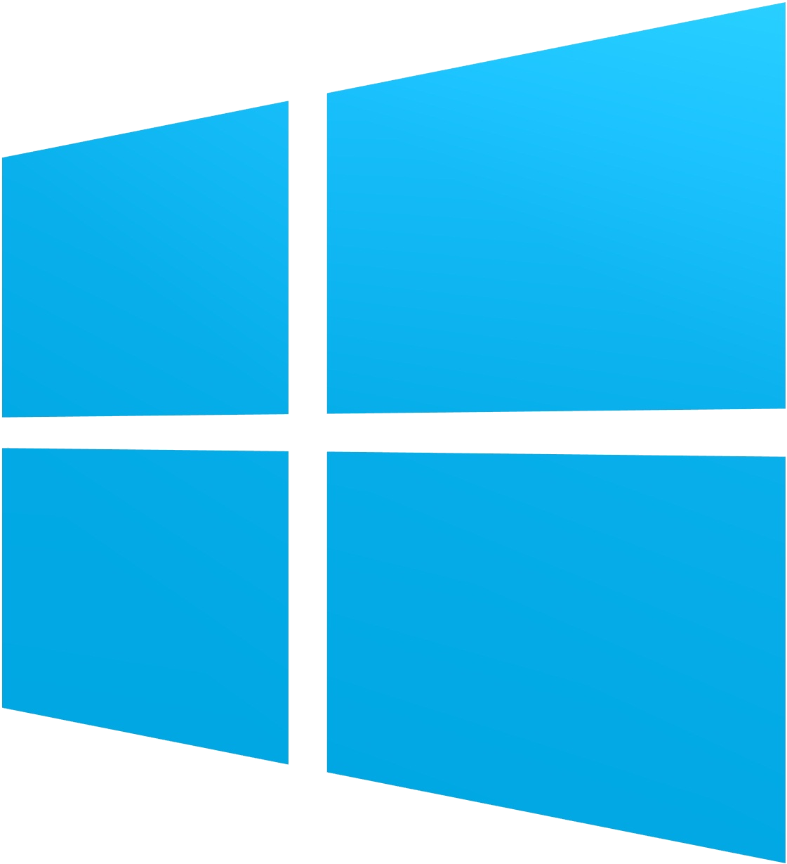
Linux is Not Windows
Problem #1: Linux isn't exactly the same as Windows.
Problem #2: Linux is too different from Windows
Problem #3: Culture shock
Problem #4: The myth of "user-friendly"
Notes:
You'd be amazed how many people make this complaint. They come to Linux, expecting to find essentially a free, open-source version of Windows. Quite often, this is what they've been told to expect by over-zealous Linux users. However, it's a paradoxical hope. As a simple example, consider driver upgrades: one typically upgrades a hardware driver on Windows by going to the manufacturer's website and downloading the new driver; whereas in Linux you upgrade the kernel. This means that a single Linux download & upgrade will give you the newest drivers available for your machine, whereas in Windows you would have to surf to multiple sites and download all the upgrades individually. It's a very different process, but it's certainly not a bad one. But many people complain because it's not what they're used to.
But switching from Windows to Linux is like switching from a car to a motorbike. They may both be OSes/road vehicles. They may both use the same hardware/roads. They may both provide an environment for you to run applications/transport you from A to B. But they use fundamentally different approaches to do so.
Windows/cars are not safe from viruses/theft unless you install an antivirus/lock the doors. Linux/motorbikes don't have viruses/doors, so are perfectly safe without you having to install an antivirus/lock any doors.
Linux users are in more of a community. They don't have to buy the software, they don't have to pay for technical support. They download software for free & use Instant Messaging and web-based forums to get help. They deal with people, not corporations.

Slide 31
References
Adapted from: Solitis, J. (2007). Introduction to Linux. New Jersey Science and Technology University
ubuntu.com
wiki.ubuntu.com
shipit.ubuntu.com
ubuntuforums.org

