Slide 1
Virtualisation US Spelling: Virtualization
Richard Wilkinson

Slide 2
What is Virtualisation
“Virtualisation means running software within a virtual environment. Virtual environments are created when Operating Systems (OS's) and desktop applications are emulated, and don't run directly on the physical hardware.” (Lanway, 2017)

Slide 3
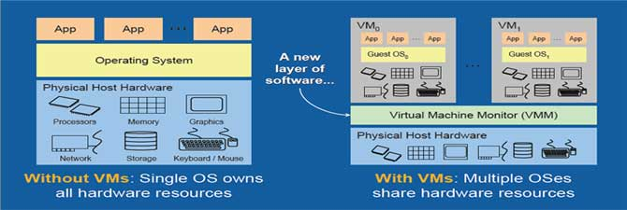
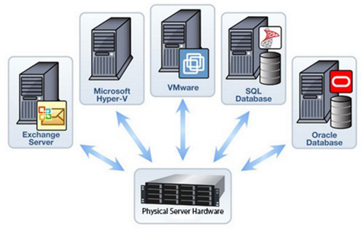
What is Virtualisation

Slide 4
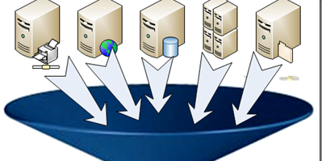
Types of Virtualisation
Software: OS, Application, Service,
Memory
Storage
Data
Network
You can even run a virtual machine within another virtual machine, called Nested Virtualisation

Slide 5
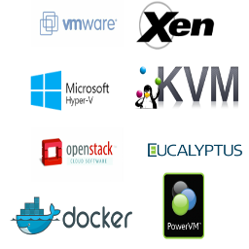
Options for Virtualisation
VMware
Oracle VirtualBox
Parallels
HyperV

Slide 6
Today’s Class
We are going to be running Oracle’s VirtualBox Software and we will be doing the following;
Creating a Virtual Machine
Installing an Operating System on a Virtual Machine
Installing Application Software onto our Virtual Machine
Creating an Appliance from our newly created Virtual Machine

Slide 7
First Issue
Before we can do all of this, we will need to make sure that Microsoft’s HyperV is turned off, as this will conflict with VirtualBox.
This means it will cause it to not work properly.

Slide 8
Virtualisation Creating a Virtual Machine in VirtualBox
Richard Wilkinson

Slide 9
Virtualisation Installing an Operating System on a Virtual Machine
Richard Wilkinson

Slide 10
Virtualisation Installing Apps on Ubuntu on a Virtual Machine
Richard Wilkinson

Slide 11
Virtualisation Creating an Appliance from a Virtual Machine
Richard Wilkinson

Slide 12
References
Lanway (2017). Virtualisation Solutions. Available at: http://www.lanway.co.uk/Pages/Virtualisation/Virtualisation.aspx [Accessed, February 2017]

